Slide 1
Collaborative Practice, Value of Community Based Arts for young people

Slide 2
“Textiles are around us, all of the time. We are intimately connected to cloth: a dress-up costume, a first sewing project, a bed sheet. Textile practices are typically labor intensive, fastidious and repetitive; the intimate nature of such handwork creates a deep connection between the artwork and its maker – and ultimately the viewer”
Curator Sarah Quinton, Close to You: Contemporary Textiles, Intimacy
Notes:
Throughout history communities across be world have told stories and represented their cultural identity in textiles that surround them. Textiles were how we learnt about each others cultures in the past, through the exchange of craft on the Silk Road and trade ships in the global textile trade. We still use the textiles around us today to represent who we are in how we dress and live. Whether weaving, felting, leatherwork or embroidery, people have recorded the chronicles of their lives or the tale of legends in cloth.
Quilting is particularly common across cultural groups to represent stories and identity.

Slide 3
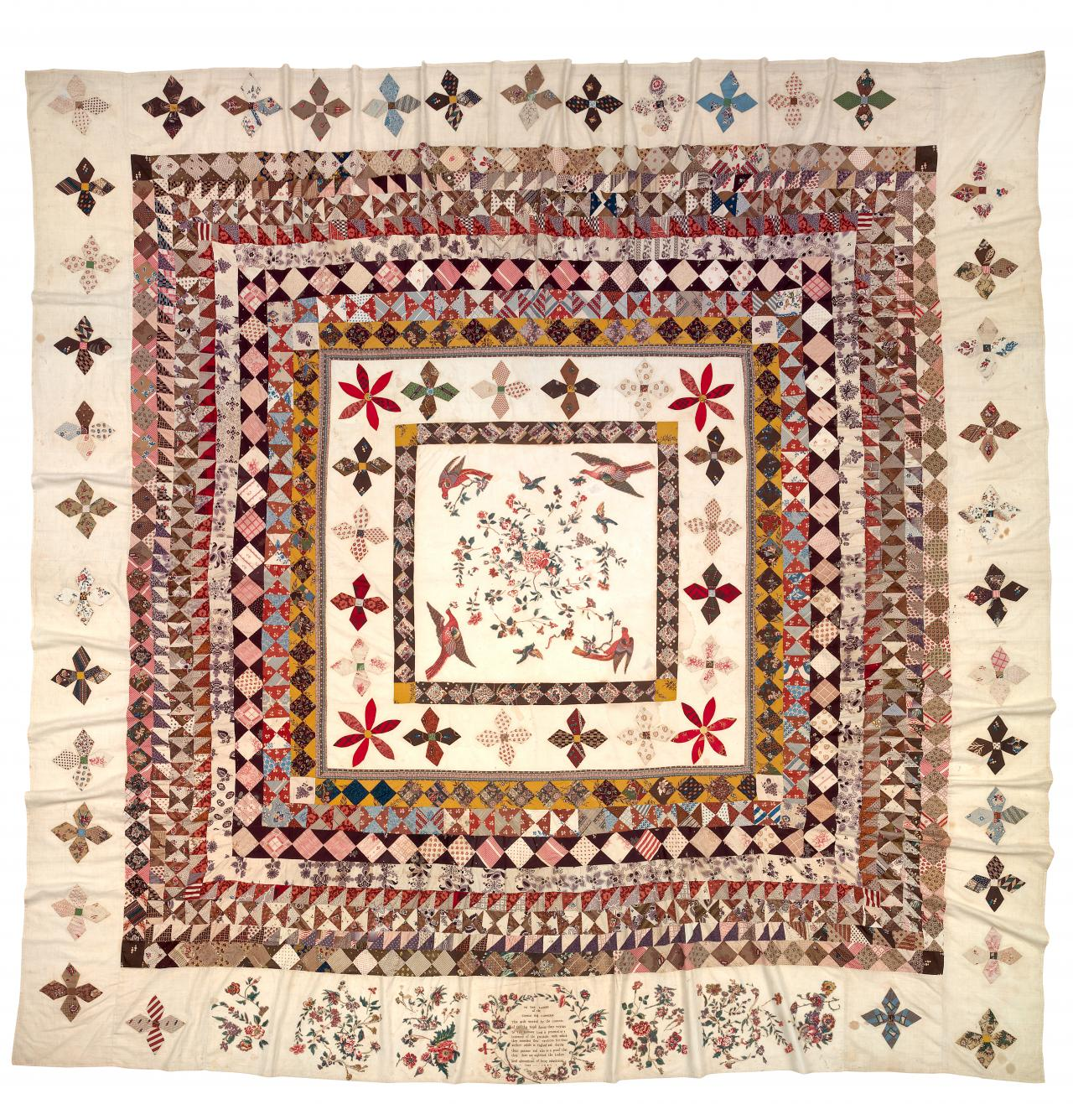
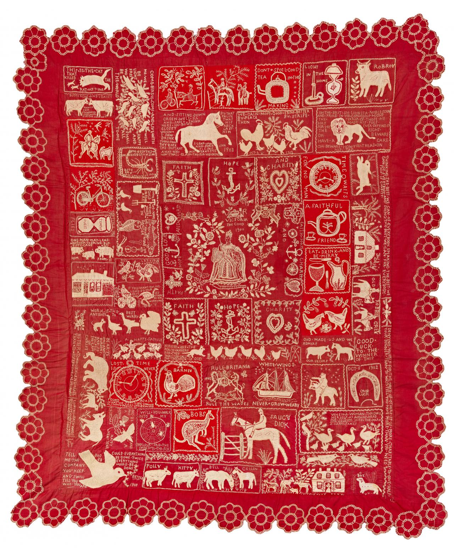
Convict women of the HMS Rajah, The Rajah quilt, (1841)
Notes:
This is the Rajah quilt, it was created On the HMS Rajah by the convict women aboard as they sailed to Australia. It was collaboratively by the women convicts, materials organized by the British Ladies’ Society for the Reformation of Female Prisoner. It is one of the first art collaborative art pieces in White Australian History.

Slide 4
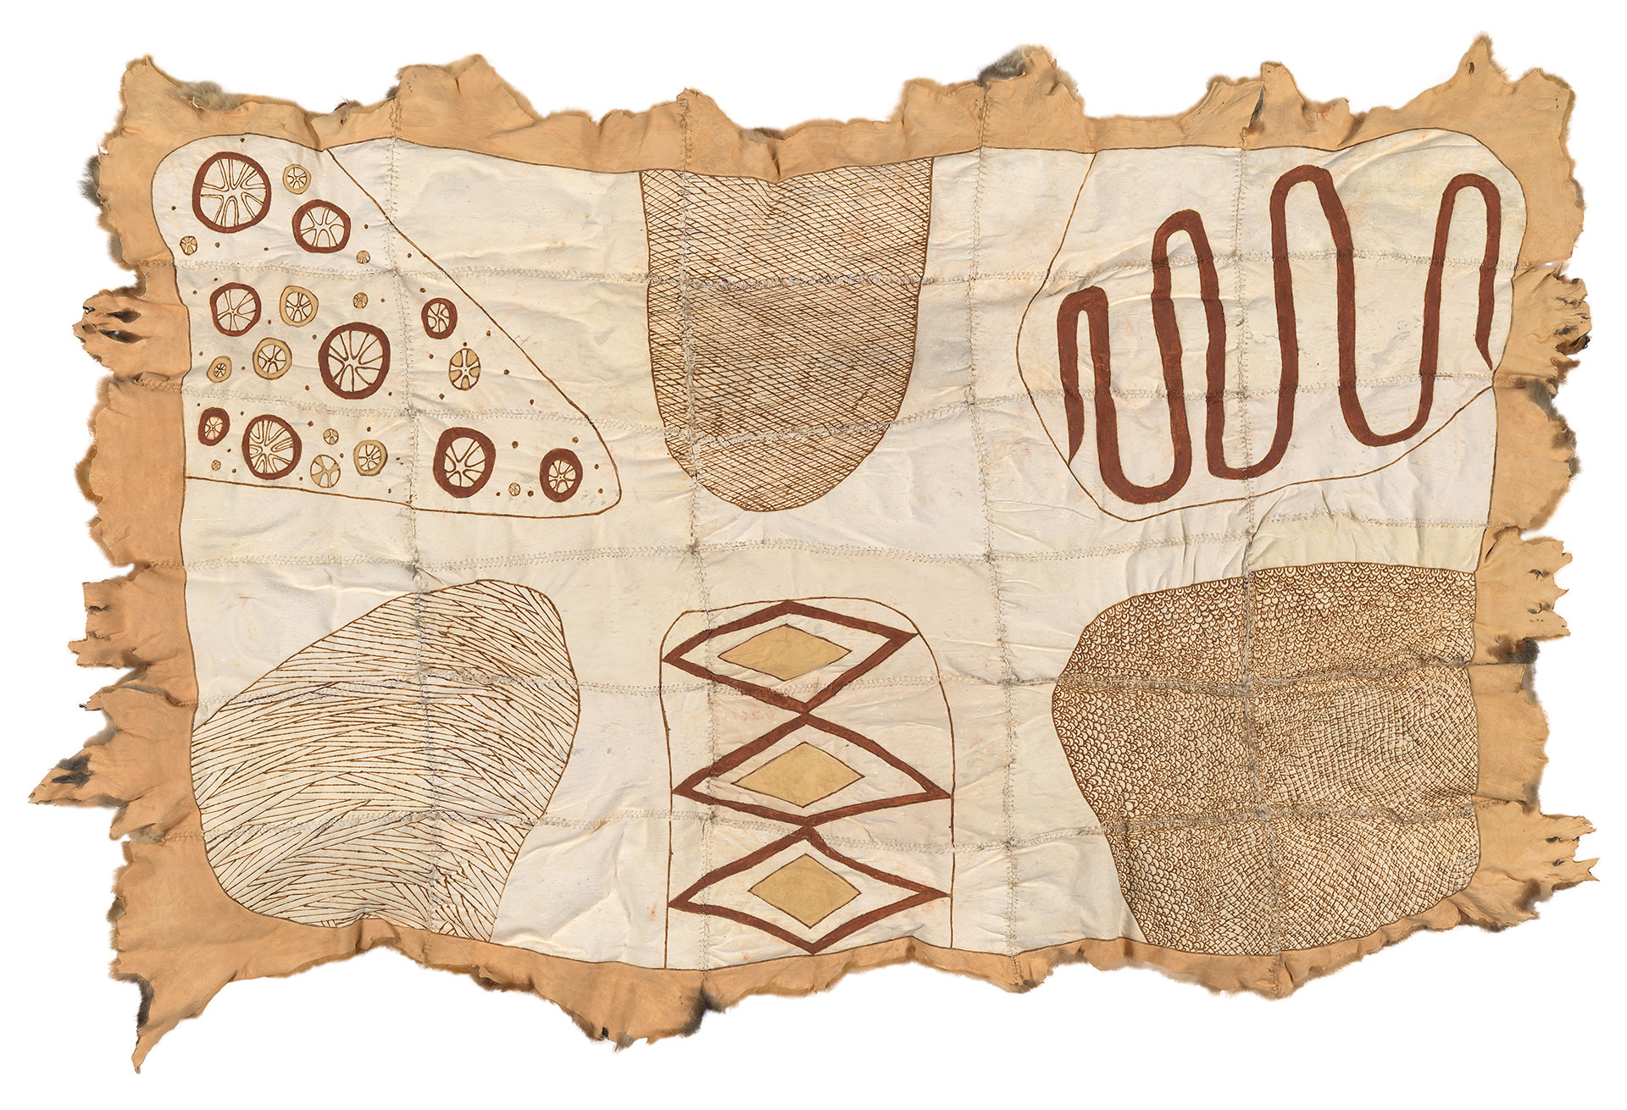
Lee Darroch, AIATSIS Possum Fur Cloak (2017)
Notes:
This possum skin cloak was commissioned by AIATSIS and was made by indigenous Victorian artist Lee Darroch. Possum skin cloaks traditionally tell the story of the wearer, “growing” through the addition of more hides as the wearer grows. As new skins are added the stories on the wearer are recorded onto them. Commonly, people were buried with their cloaks and so there are few originals, however artists, such as Darroch, have created replicas or cloaks, such as this one, with traditional techniques with contemporary stories.

Slide 5
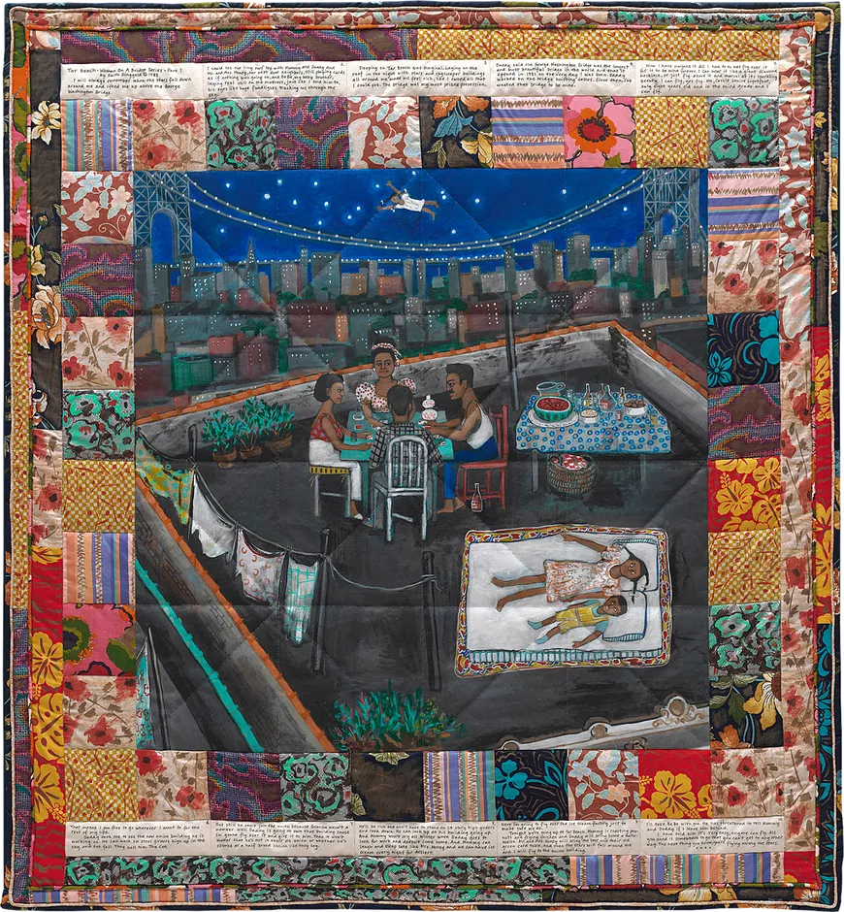
Faith Ringgold, Tar Beach (Part I from the Woman on a Bridge series) (1988)
Notes:
Quilts have also been used to tell stories within fine art. Tar Beach is a story quilt, part of a series of such quilts, by Faith Ringgold. Ringgold is an African American artist and this series is about her lived experiences growing up in Brooklyn. Ringgold often produced these quilts collaboratively with her mother.

Slide 6
Today we are making a quilt of our stories, interweaving them to represent the interwoven relationships of this community we are in today.
Splitting into pairs (with someone you don’t know), you will swap zines and share stories of who you are, your identity and what you do on the weekend.
You will then create a patch to represent your partner and who they are. Working with any mixture of materials and techniques.
You must use one of the provided squares.
Notes:
This deep connection created through interaction with textiles between the artwork, maker and viewer is the reason we will be working with textiles today.
Similar to the examples, we will be making a quilt of our stories, interweaving them just as all of our stories have interwoven today from being a community in this space.
I have arranged the room so you are sitting in front of someone, you will read each other’s zines before discussing the ways you have demonstrated who you are through the symbolism, colours and imagery used.
You will then create a quilt patch to represent your partner, considering how they explained themselves and how you understood them.

Slide 7
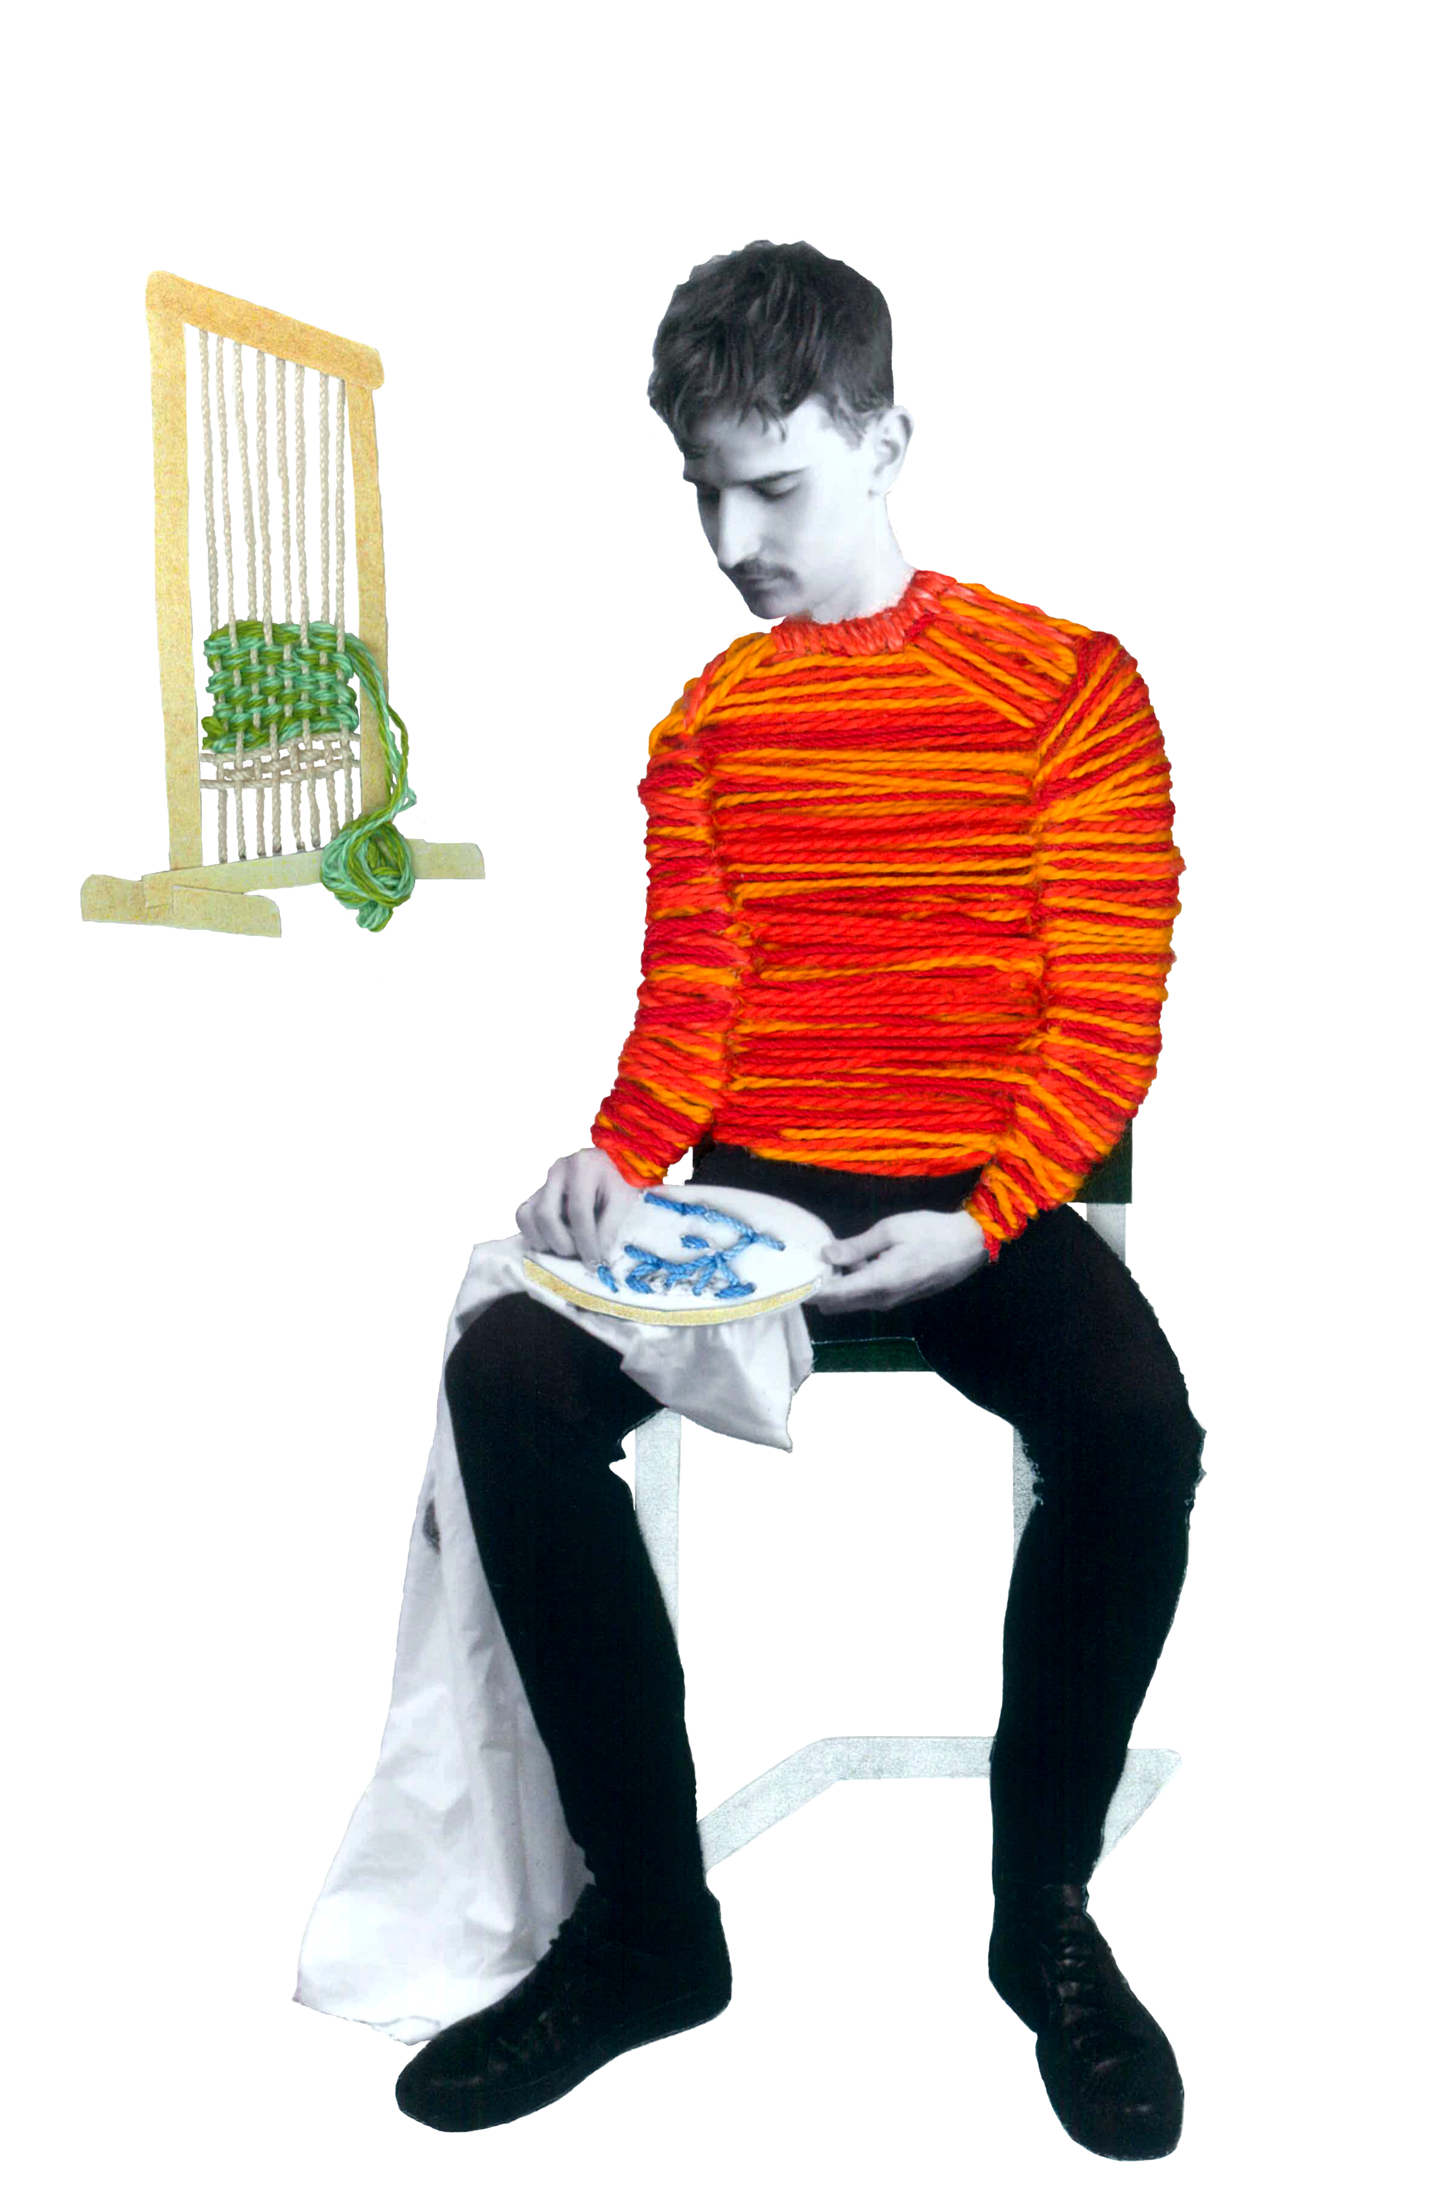
Notes:
Here is an example of a patch. You don’t need to choose such a literal representation of the person, you may decide to instead focus on symbolism. But do consider the different ways you can you the materials provided to create and juxtapose a variety of textures, just as in this examples of my own practice where I have combined embroidery, photography and collage.

Slide 8
10 minutes to share zines and stories with partner
Breaking to work on your patch square
Coming together at 12 to create our quilt

